Slide 1
RA Assignment 2- Group 3
Chandra Sekhar Rachannagari
Maha Vajeeshwaran Navaneethan
Stefanos Sakellariou
Youheng Lü

Slide 2
1. Derive the mean of log stock returns of the companies and comment on your results.
Stock name | Mean log return
Apple | 0.0010
Microsoft | 0.0008
Intel | 0.0003
Walmart | 0.0003
Coca Cola | 0.0002
Apple has the highest mean log return and Coca-Cola the lowest
Apple is the best stock to invest in

Slide 3
2. Derive the standard deviation of log stock returns of the companies.
Intel has the highest standard deviation log return and Coca-Cola has the lowest
Similar standard deviation log return for all stocks
Stock name | Standard deviation log returns
Apple | 0.0177
Microsoft | 0.0158
Intel | 0.0180
Walmart | 0.0118
Coca Cola | 0.0110

Slide 4
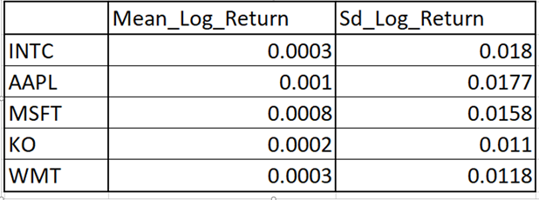
3. Create a data frame for the 5 companies with each company's average log return and standard deviation, and compare their stock performances. Which stock would you buy, why?
Apple and Microsoft are both good options to invest in
Coca -Cola carries the lowest risk but has a very low expected return as well

Slide 5
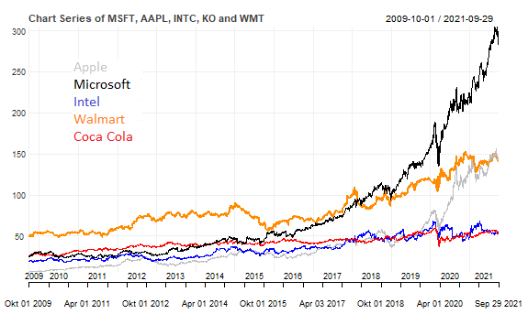
4. Make a risk analysis of the stock’s performance with a chart series (subset 2020) for the companies. You may also consider Bollinger bands.

Slide 6
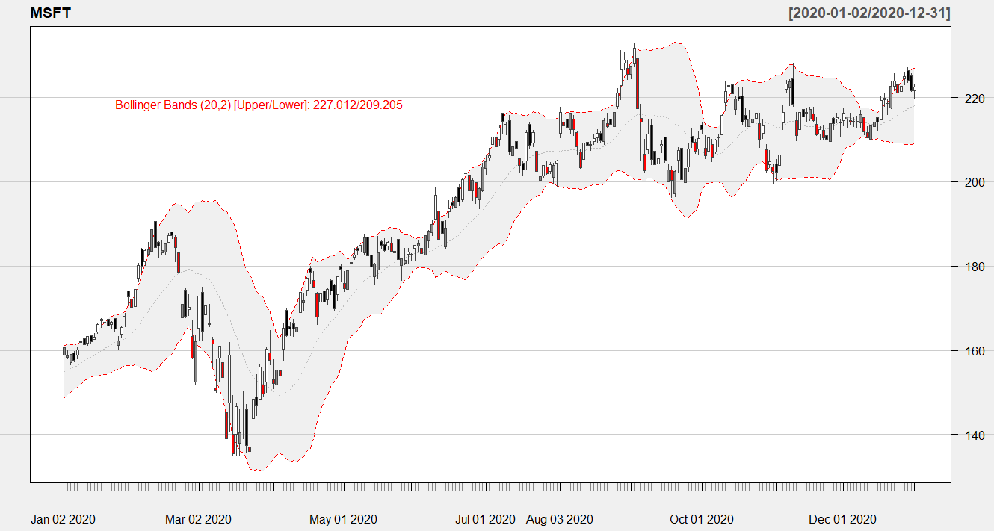
4. Make a risk analysis of the stock’s performance with a chart series (subset 2020) for the companies. You may also consider Bollinger bands.
Microsoft stock Bollinger band for the year 2020
In 2020, the pandemic seriously affected the stock market in general, thus leading to a steep decline of the stock’s price.
However, this decline lasted for less than two months, Then the upward trend continued until the stock price reached its highest level of the year in mid-September 2020

Slide 7

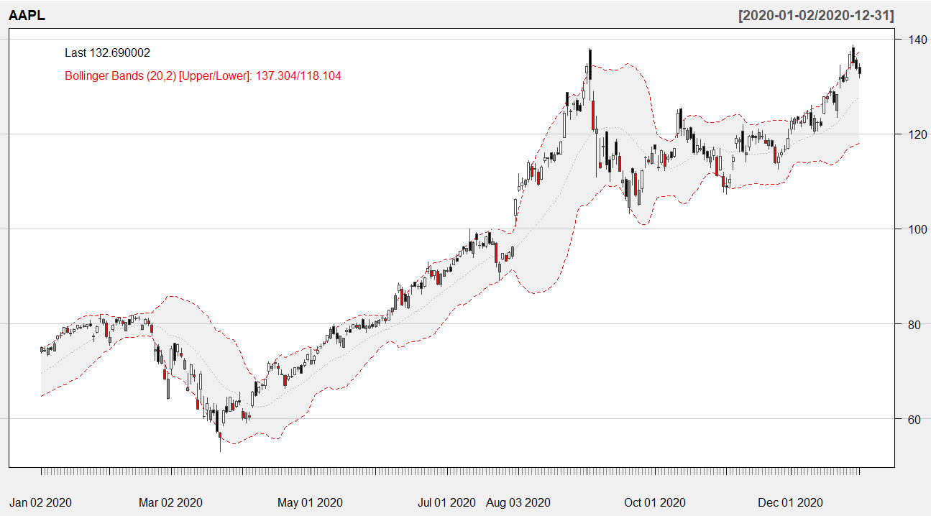
4. Make a risk analysis of the stock’s performance with a chart series (subset 2020) for the companies. You may also consider Bollinger bands.
Apple stock Bollinger band for the year 2020
After a period of low volatility and stability from 2009 to 2014, in 2016 the stock price entered a period of higher volatility.
The 2020 epidemic had a significant impact on the stock market, which we analyze in Figure
This collapse, however, lasted less than two months. Following that, we can see an exceptionally quick growth until June, when the price level dropped slightly.

Slide 8
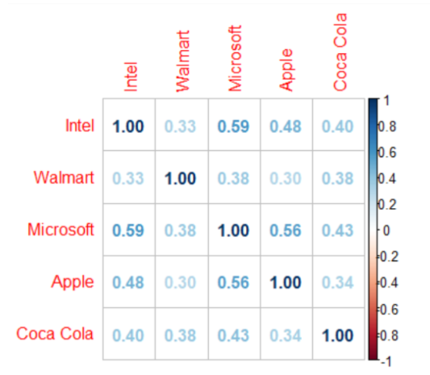
5. Analyze the correlation of the company's stock and explain the risk of buying stocks from the same or different sectors
Correlation between the different stocks
Stocks from the same sector have a higher
correlation. Therefore, Apple, MSFT, and Intel
have a higher correlation
Investing in stocks with high correlation
carries higher risk

Slide 9
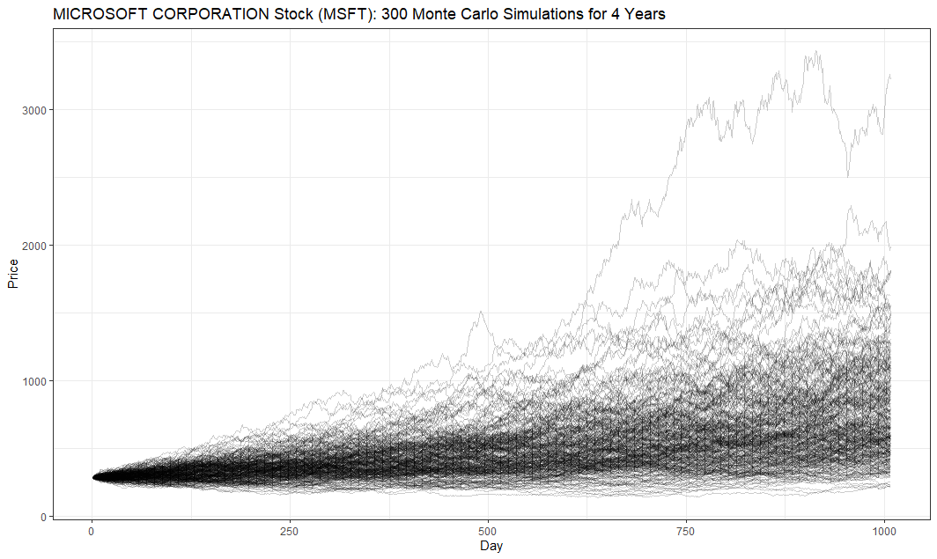
6. Simulate for the next 4 years the stock prices of Microsoft Corporation using Monte Carlo. Will you buy Microsoft’s stock and why?
300 Monte Carlo Simulations
Assumption: Daily growth rate is normally distributed

Slide 10

6. Simulate for the next 4 years the stock prices of Microsoft Corporation using Monte Carlo . Will you buy Microsoft’s stock and why?
Distribution of the end prices
General distribution of all the end
prices after 4 years, using a Monte
Carlo simulation
We compare our results with the starting value
The average profit: Mean(end Values) / (start Value) is 2.6
For every $1 we put in, we can expect to get $2.6 at the end of year 4

Slide 11
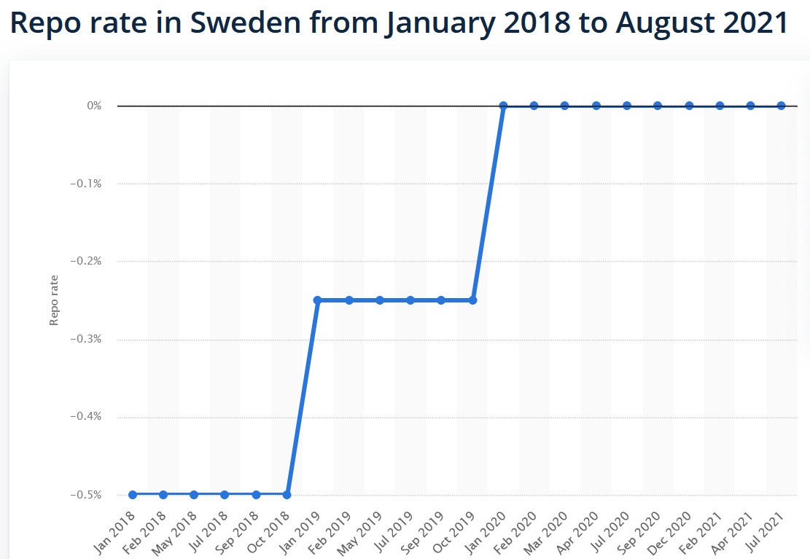
6. Simulate for the next 4 years the stock prices of Microsoft Corporation using Monte Carlo. Will you buy Microsoft’s stock and why?
If we beat Repo rate, we make profit.
With Microsoft we beat Repo rate 98% of the time:
Probability of making profit:
#(end Value > start Value )
/ # Simulations = 0.98
-> We would buy Microsoft stock

Slide 12
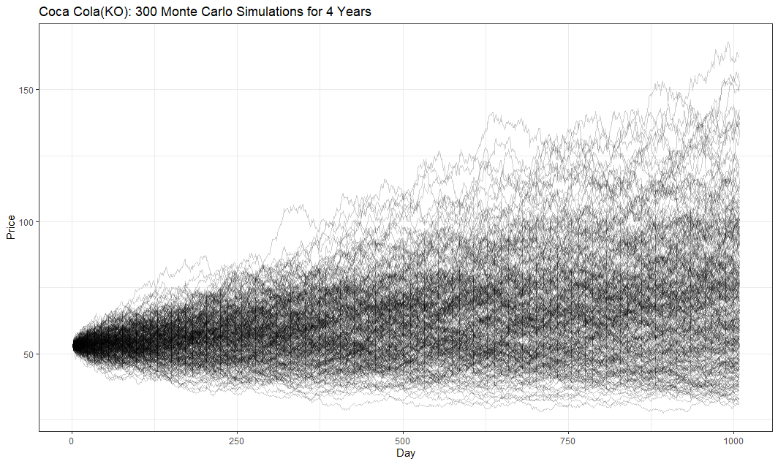
7. Suggest your favourite trading strategy and provide an intuitive motivation for your strategy. Code you rule and assess your strategy using the Monte Carlo simulation.
Coca Cola
Profit: 74% of the time
Mean Profit: 1.33
-> Don’t buy!

Slide 13
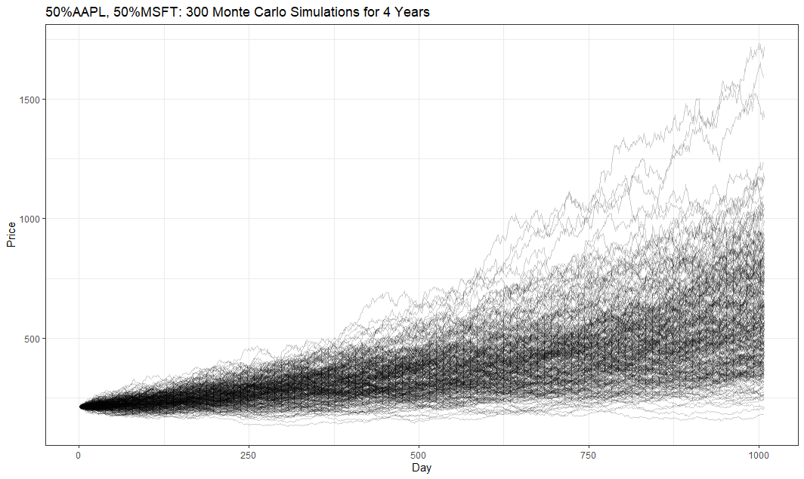
7. Suggest your favourite trading strategy and provide an intuitive motivation for your strategy. Code you rule and assess your strategy using the Monte Carlo simulation.
Our Portfolio: ½ Apple, ½ Microsoft
Reason: All other stock perform a lot worse
Our portfolio performs better than just the Microsoft stock:
mean(end Value) / (start Value)
=2.7 > 2.6
#(end Value > start Value) / # Simulations
= 0.99 > 0.98

Slide 14
Thank you for listening!

Slide 15
Sources:
[1] Sweden Repo rate: https://www.statista.com/statistics/1116954/repo-rate-in-sweden/#:~:text=The%20repo%20rate%20in%20Sweden%20was%20negative%20for,stimulates%20demand%20in%20the%20economy%2C%20and%20affect%20inflation.

